Slide 1

Brenden Eum
RNL Lab Meeting
2024.02.23

Slide 4
Subject 1
Subject 2
Gain
Gain
Loss
Loss

Slide 5
Subject 1
Subject 2
aDDM
Gain
Gain
aDDM
aDDM
Loss
Loss
aDDM

Slide 6
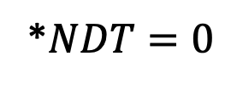
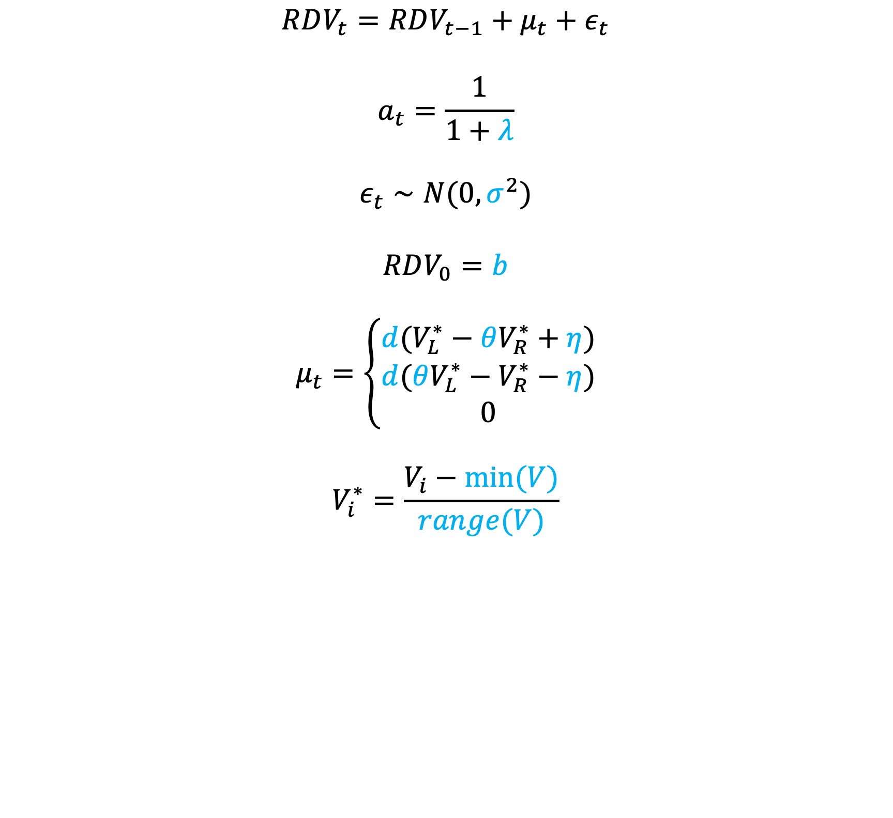
$$RDV_{t}=RDV_{t−1}+μ_{t}+ε_{t}$$
$$a_{t}=\frac{1}{1+λ}$$
$$ε_{t}∼N(0,σ^{2})$$
$$RDV_{0}=b$$
$$μ_{t}=\left\{\begin{aligned}d(V_{L}^{∗}−θV_{R}^{∗}+η) \\ d(θV_{L}^{∗}−V_{R}^{∗}−η) \\ 0\end{aligned}\right.$$
$$V_{i}^{∗}=\frac{V_{i}−min⁡(V)}{range⁡(V)}$$
*$NDT=0$

Slide 7
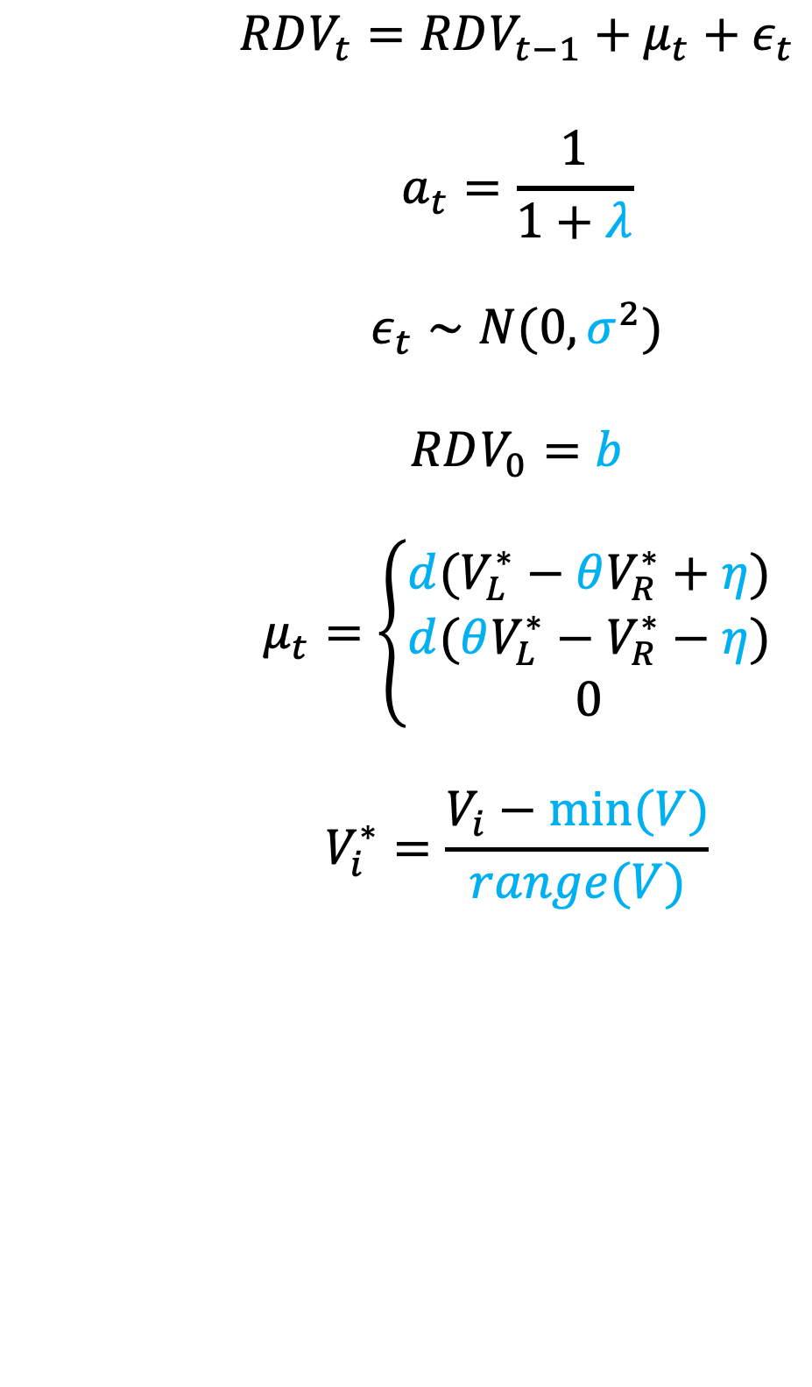
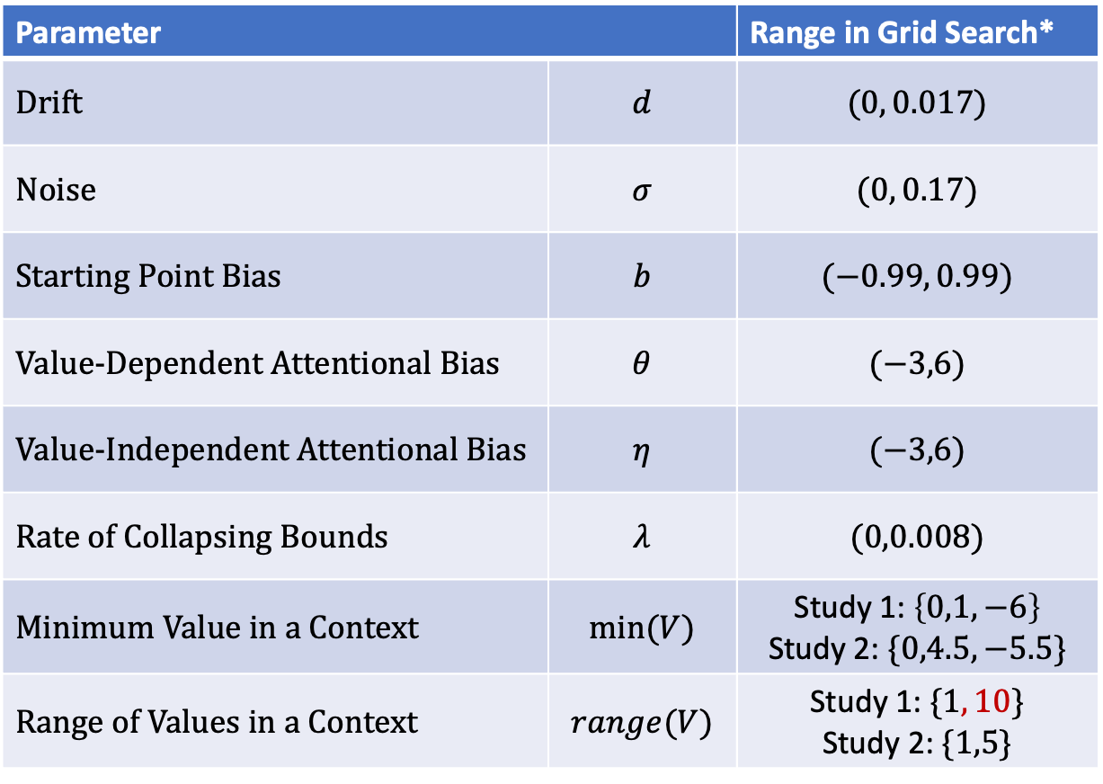
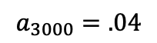
$$RDV_{t}=RDV_{t−1}+μ_{t}+ε_{t}$$
$$a_{t}=\frac{1}{1+λ}$$
$$ε_{t}∼N(0,σ^{2})$$
$$RDV_{0}=b$$
$$μ_{t}=\left\{\begin{aligned}d(V_{L}^{∗}−θV_{R}^{∗}+η) \\ d(θV_{L}^{∗}−V_{R}^{∗}−η) \\ 0\end{aligned}\right.$$
$$V_{i}^{∗}=\frac{V_{i}−min⁡(V)}{range⁡(V)}$$
Parameter | Parameter | Range in Grid Search*
Drift | $$d$$ | $$(0, 0.017)$$
Noise | $$σ$$ | $$(0, 0.17)$$
Starting Point Bias | $$b$$ | $$(−0.99, 0.99)$$
Value-Dependent Attentional Bias | $$θ$$ | $$(−3,6)$$
Value-Independent Attentional Bias | $$η$$ | $$(−3,6)$$
Rate of Collapsing Bounds | $$λ$$ | $$(0,0.008)$$
Minimum Value in a Context | $$min⁡(V)$$ | Study 1: $\left\{0,1,−6\right\}$ Study 2: $\{0,4.5,−5.5\}$
Range of Values in a Context | $$range(V)$$ | Study 1: $\{1, 10\}$ Study 2: $\{1,5\}$
$$a_{3000}=.04$$
* Up to 10 iterations

Slide 8
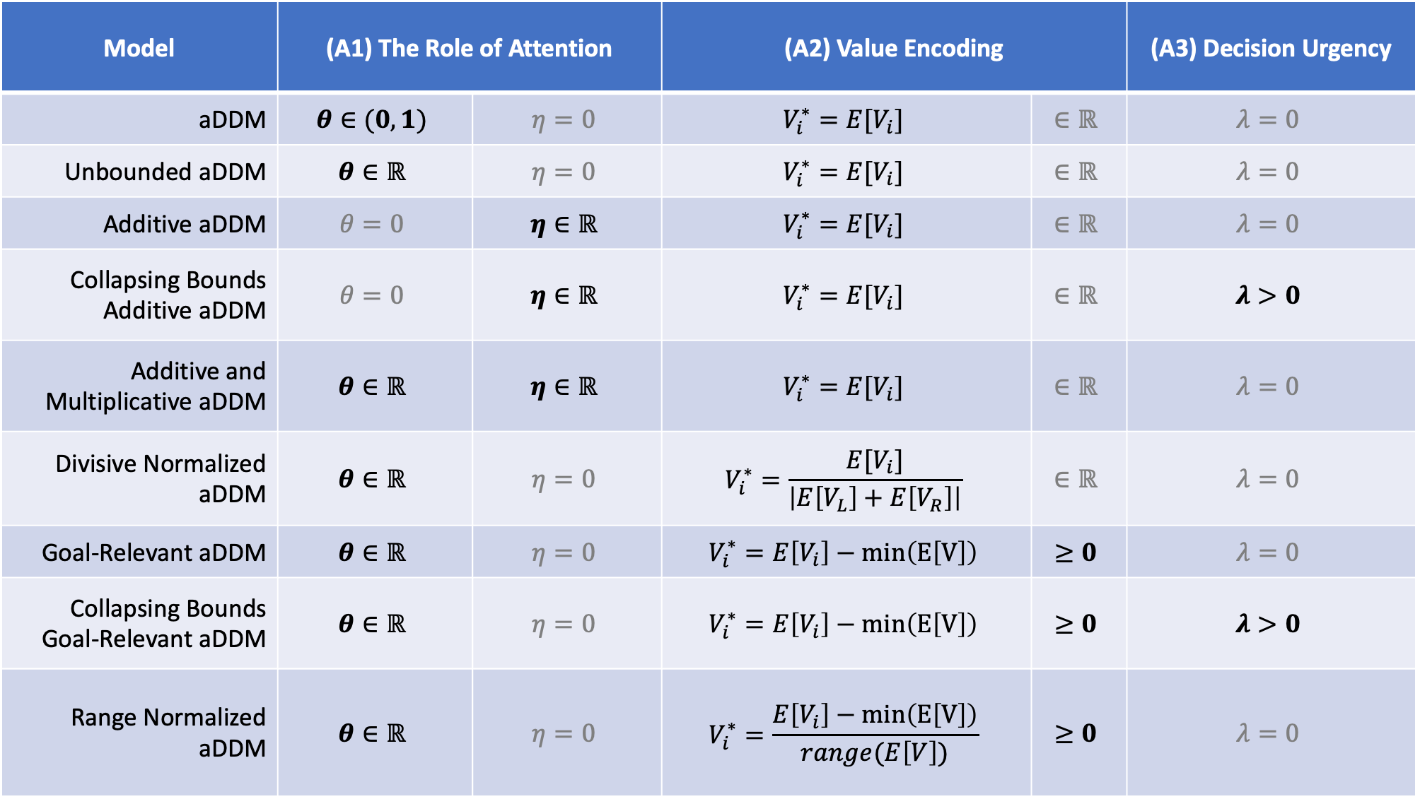
Model | (A1) The Role of Attention |  | (A2) Value Encoding |  | (A3) Decision Urgency
aDDM | $$θ∈(0,1)$$ | $$η=0$$ | $$V_{i}^{∗}=E[V_{i}]$$ | $$∈ℝ$$ | $$λ=0$$
Unbounded aDDM | $$θ∈ℝ$$ | $$η=0$$ | $$V_{i}^{∗}=E[V_{i}]$$ | $$∈ℝ$$ | $$λ=0$$
Additive aDDM | $$θ=0$$ | $$η∈ℝ$$ | $$V_{i}^{∗}=E[V_{i}]$$ | $$∈ℝ$$ | $$λ=0$$
Collapsing Bounds Additive aDDM | $$θ=0$$ | $$η∈ℝ$$ | $$V_{i}^{∗}=E[V_{i}]$$ | $$∈ℝ$$ | $$λ>0$$
Additive and Multiplicative aDDM | $$θ∈ℝ$$ | $$η∈ℝ$$ | $$V_{i}^{∗}=E[V_{i}]$$ | $$∈ℝ$$ | $$λ=0$$
Divisive Normalized aDDM | $$θ∈ℝ$$ | $$η=0$$ | $$V_{i}^{∗}=\frac{E[V_{i}]}{\left|E\left[V_{L}\right]+E\left[V_{R}\right]\right|}$$ | $$∈ℝ$$ | $$λ=0$$
Goal-Relevant aDDM | $$θ∈ℝ$$ | $$η=0$$ | $$V_{i}^{∗}=E\left[V_{i}\right]−min\left(E\left[V\right]\right)$$ | $$≥0$$ | $$λ=0$$
Collapsing Bounds Goal-Relevant aDDM | $$θ∈ℝ$$ | $$η=0$$ | $$V_{i}^{∗}=E\left[V_{i}\right]−min\left(E\left[V\right]\right)$$ | $$≥0$$ | $$λ>0$$
Range Normalized aDDM | $$θ∈ℝ$$ | $$η=0$$ | $$V_{i}^{∗}=\frac{E\left[V_{i}\right]−min\left(E\left[V\right]\right)}{range(E\left[V\right])}$$ | $$≥0$$ | $$λ=0$$

Slide 9
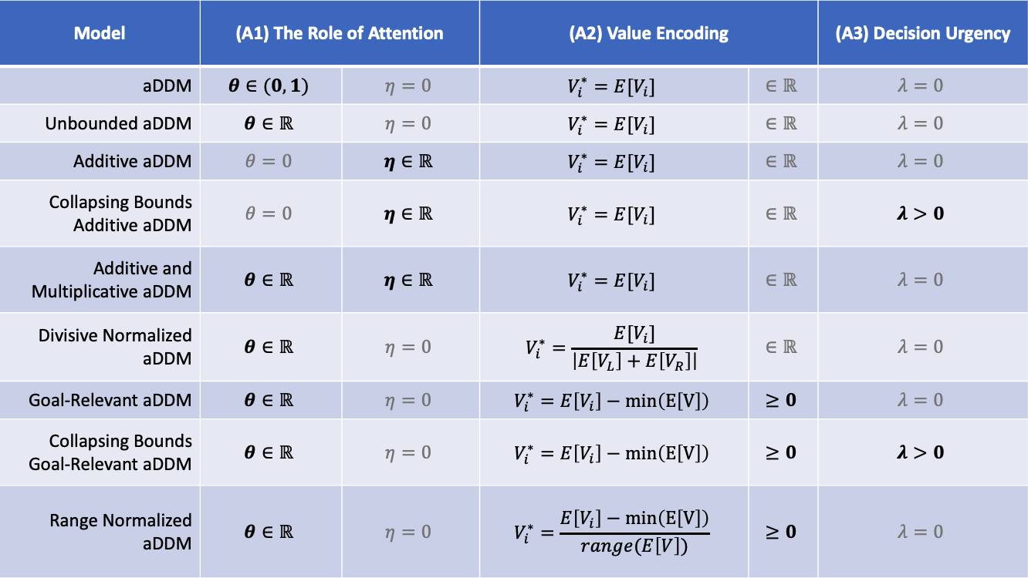

Slide 10
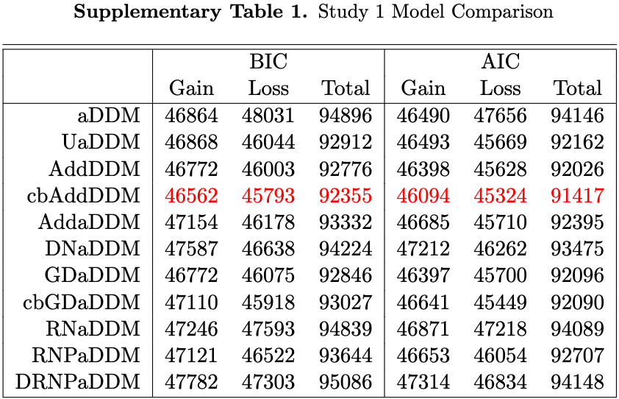
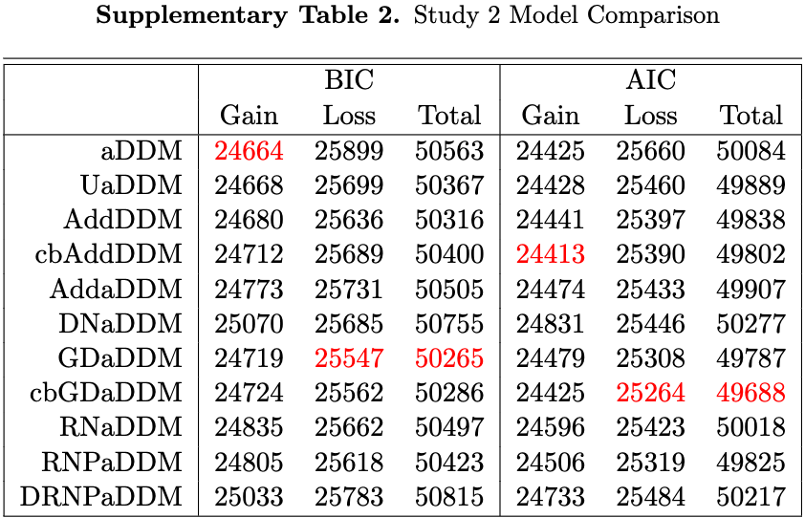

Slide 11
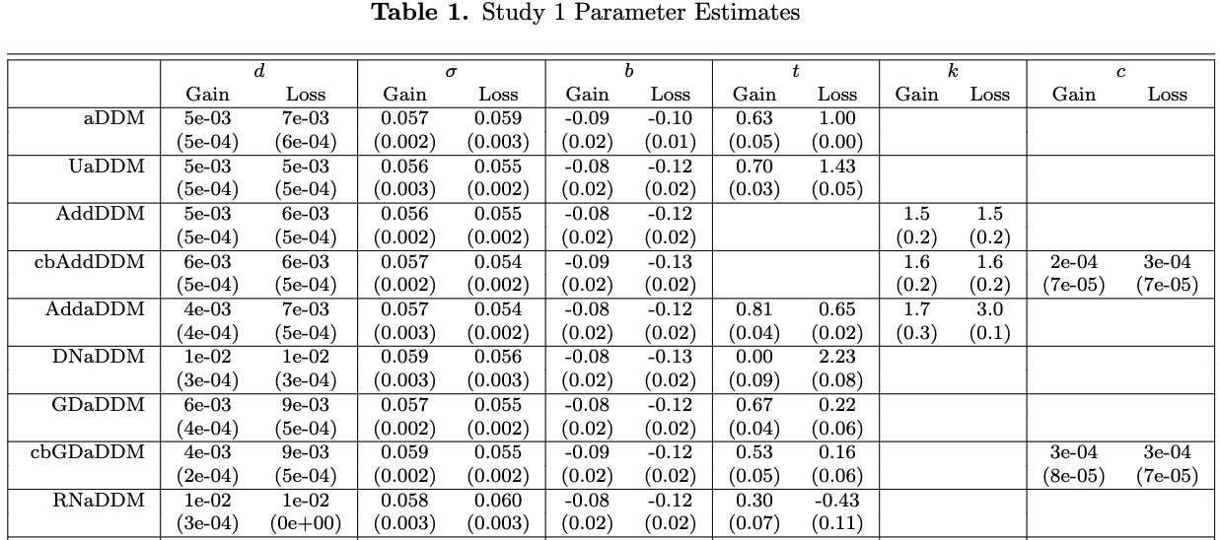
Standard
Unbounded
Additive
Urgency + Add.
Unbounded + Add.
Div. Norm.
Goal Relevant
Urgency + Goal Relevant
Range Normalized (RN)

Slide 12
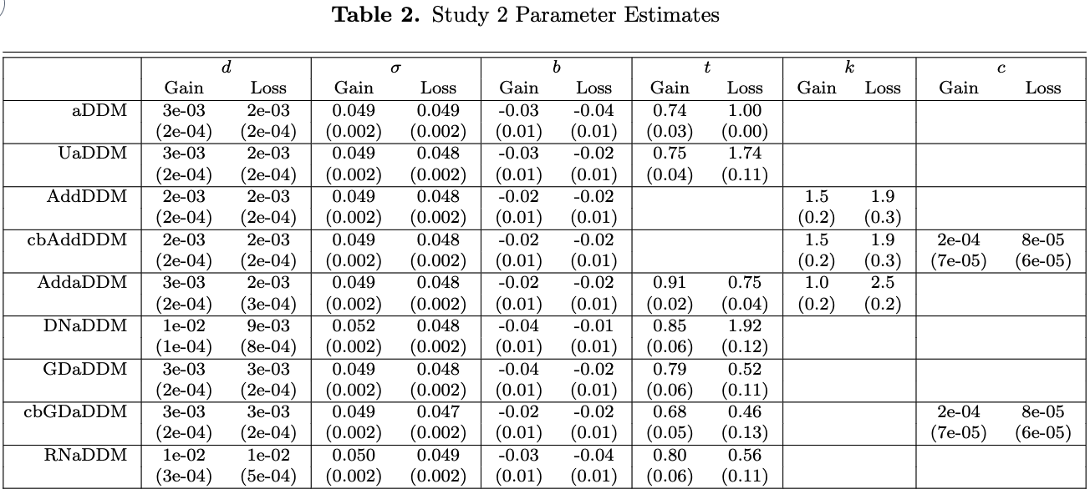
Standard
Unbounded
Additive
Urgency + Add.
Unbounded + Add.
Div. Norm.
Goal Relevant
Urgency + Goal Relevant
Range Normalized (RN)

Slide 15


